Slide 1
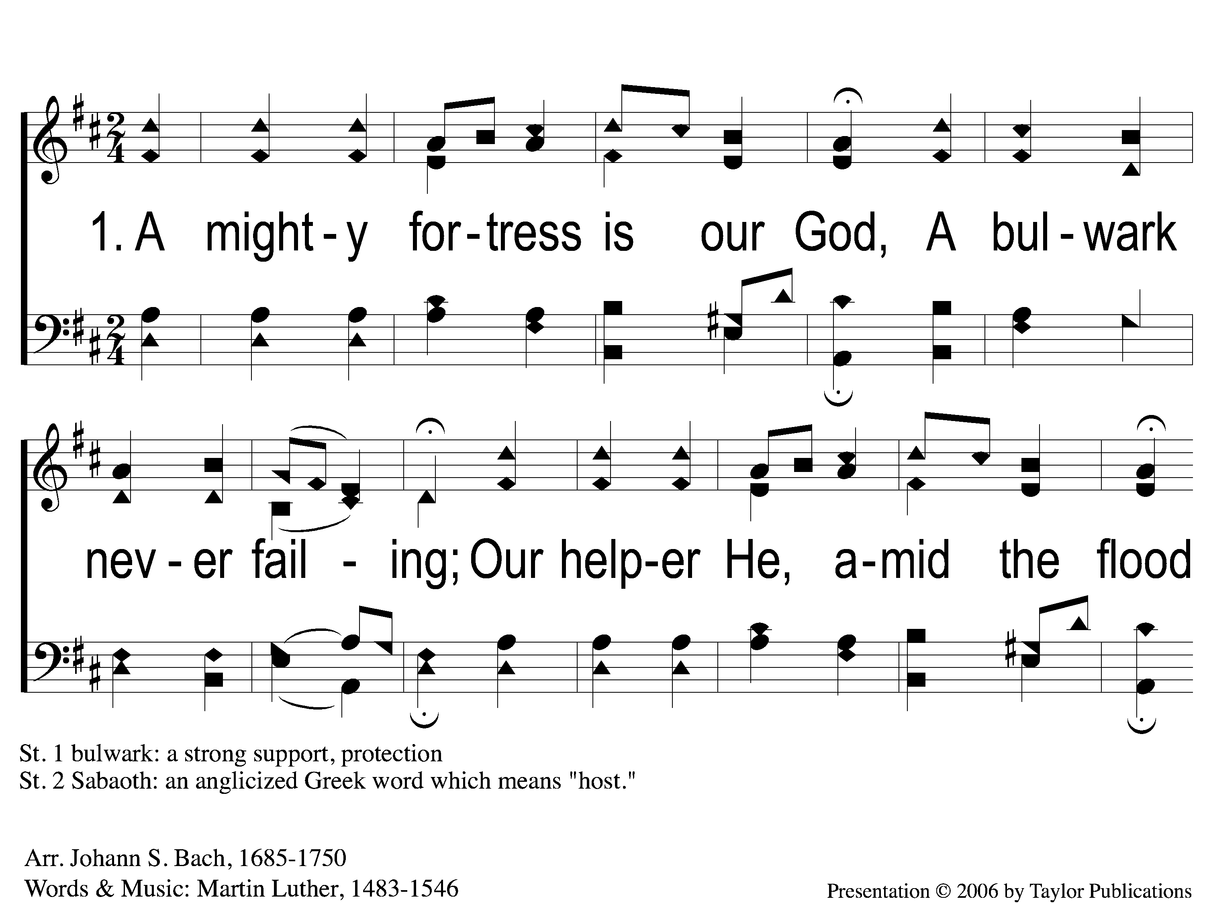
1-1 A Mighty Fortress
A Mighty Fortress
3

Slide 2
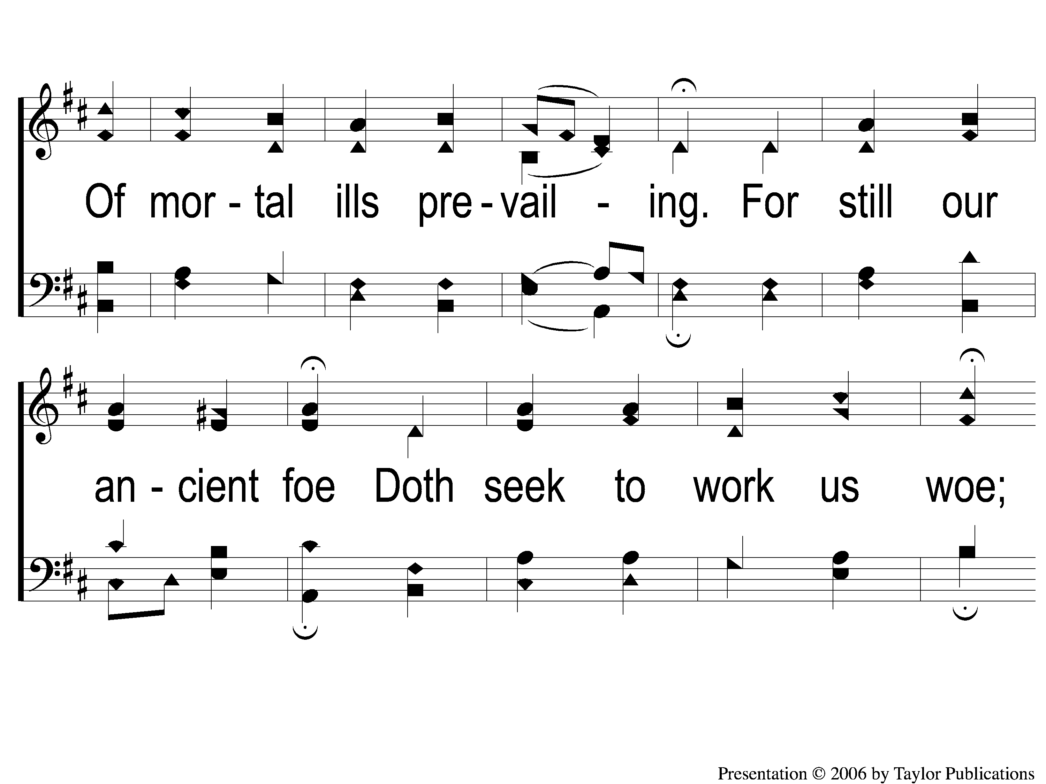
1-2 A Mighty Fortress
A Mighty Fortress
3

Slide 3
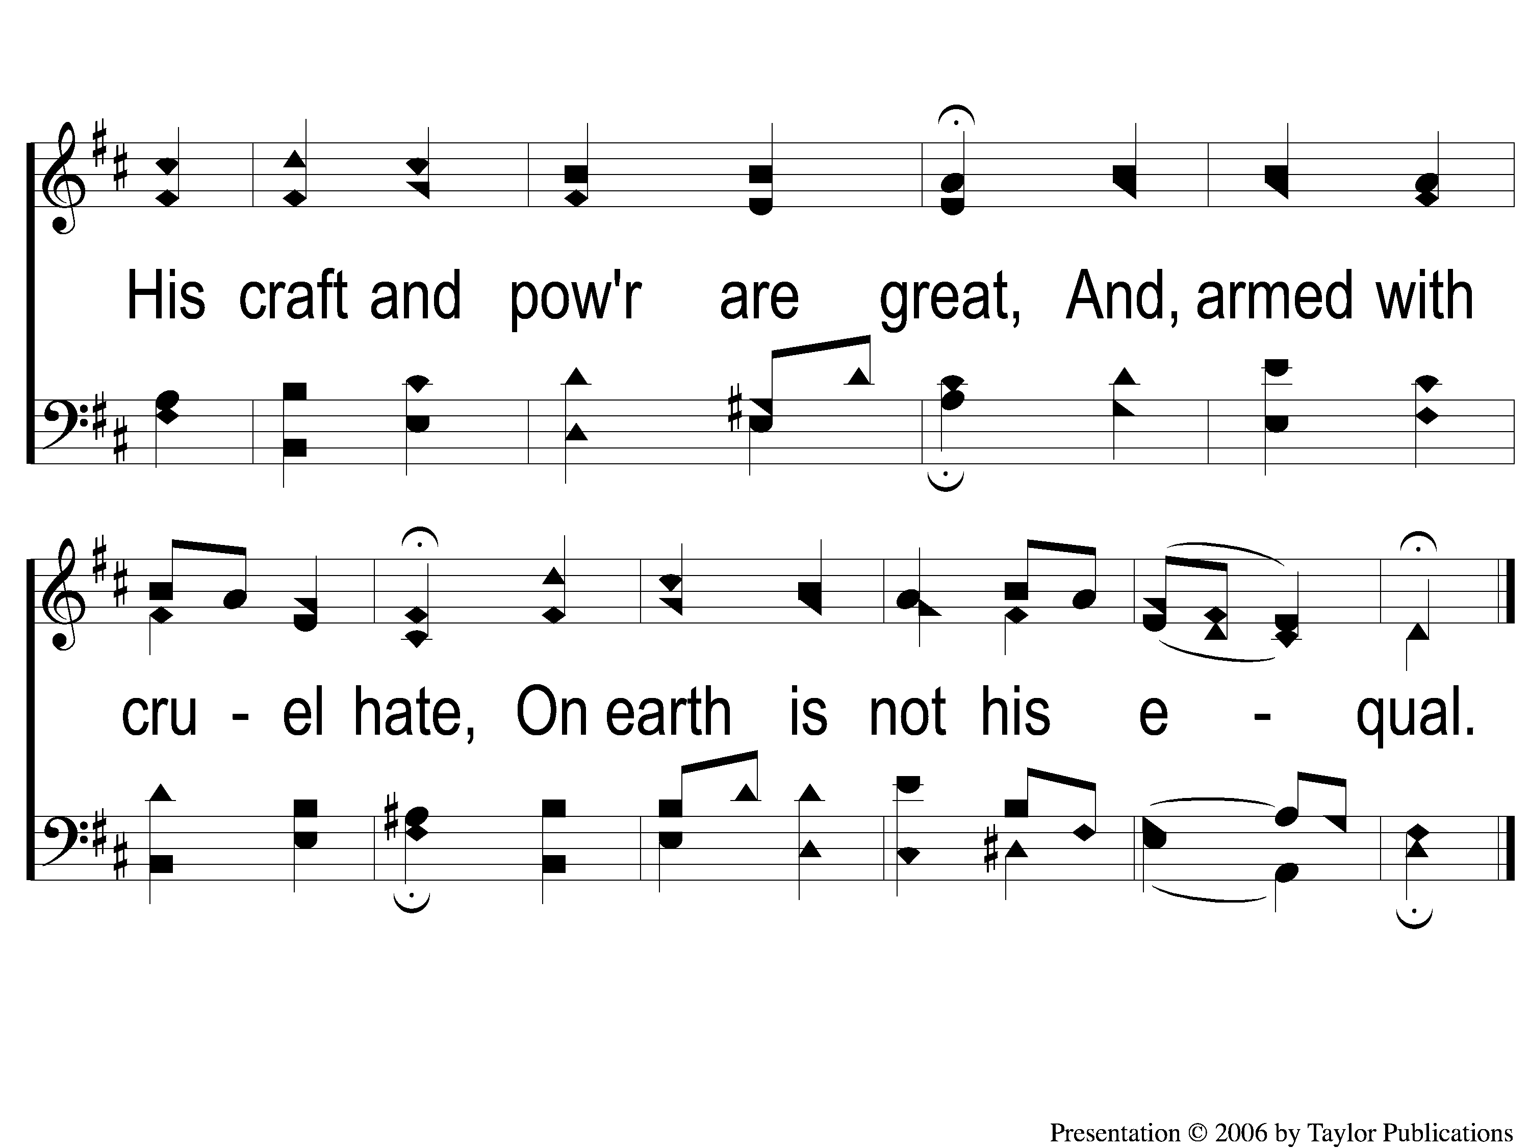
1-3 A Mighty Fortress
A Mighty Fortress
3

Slide 4
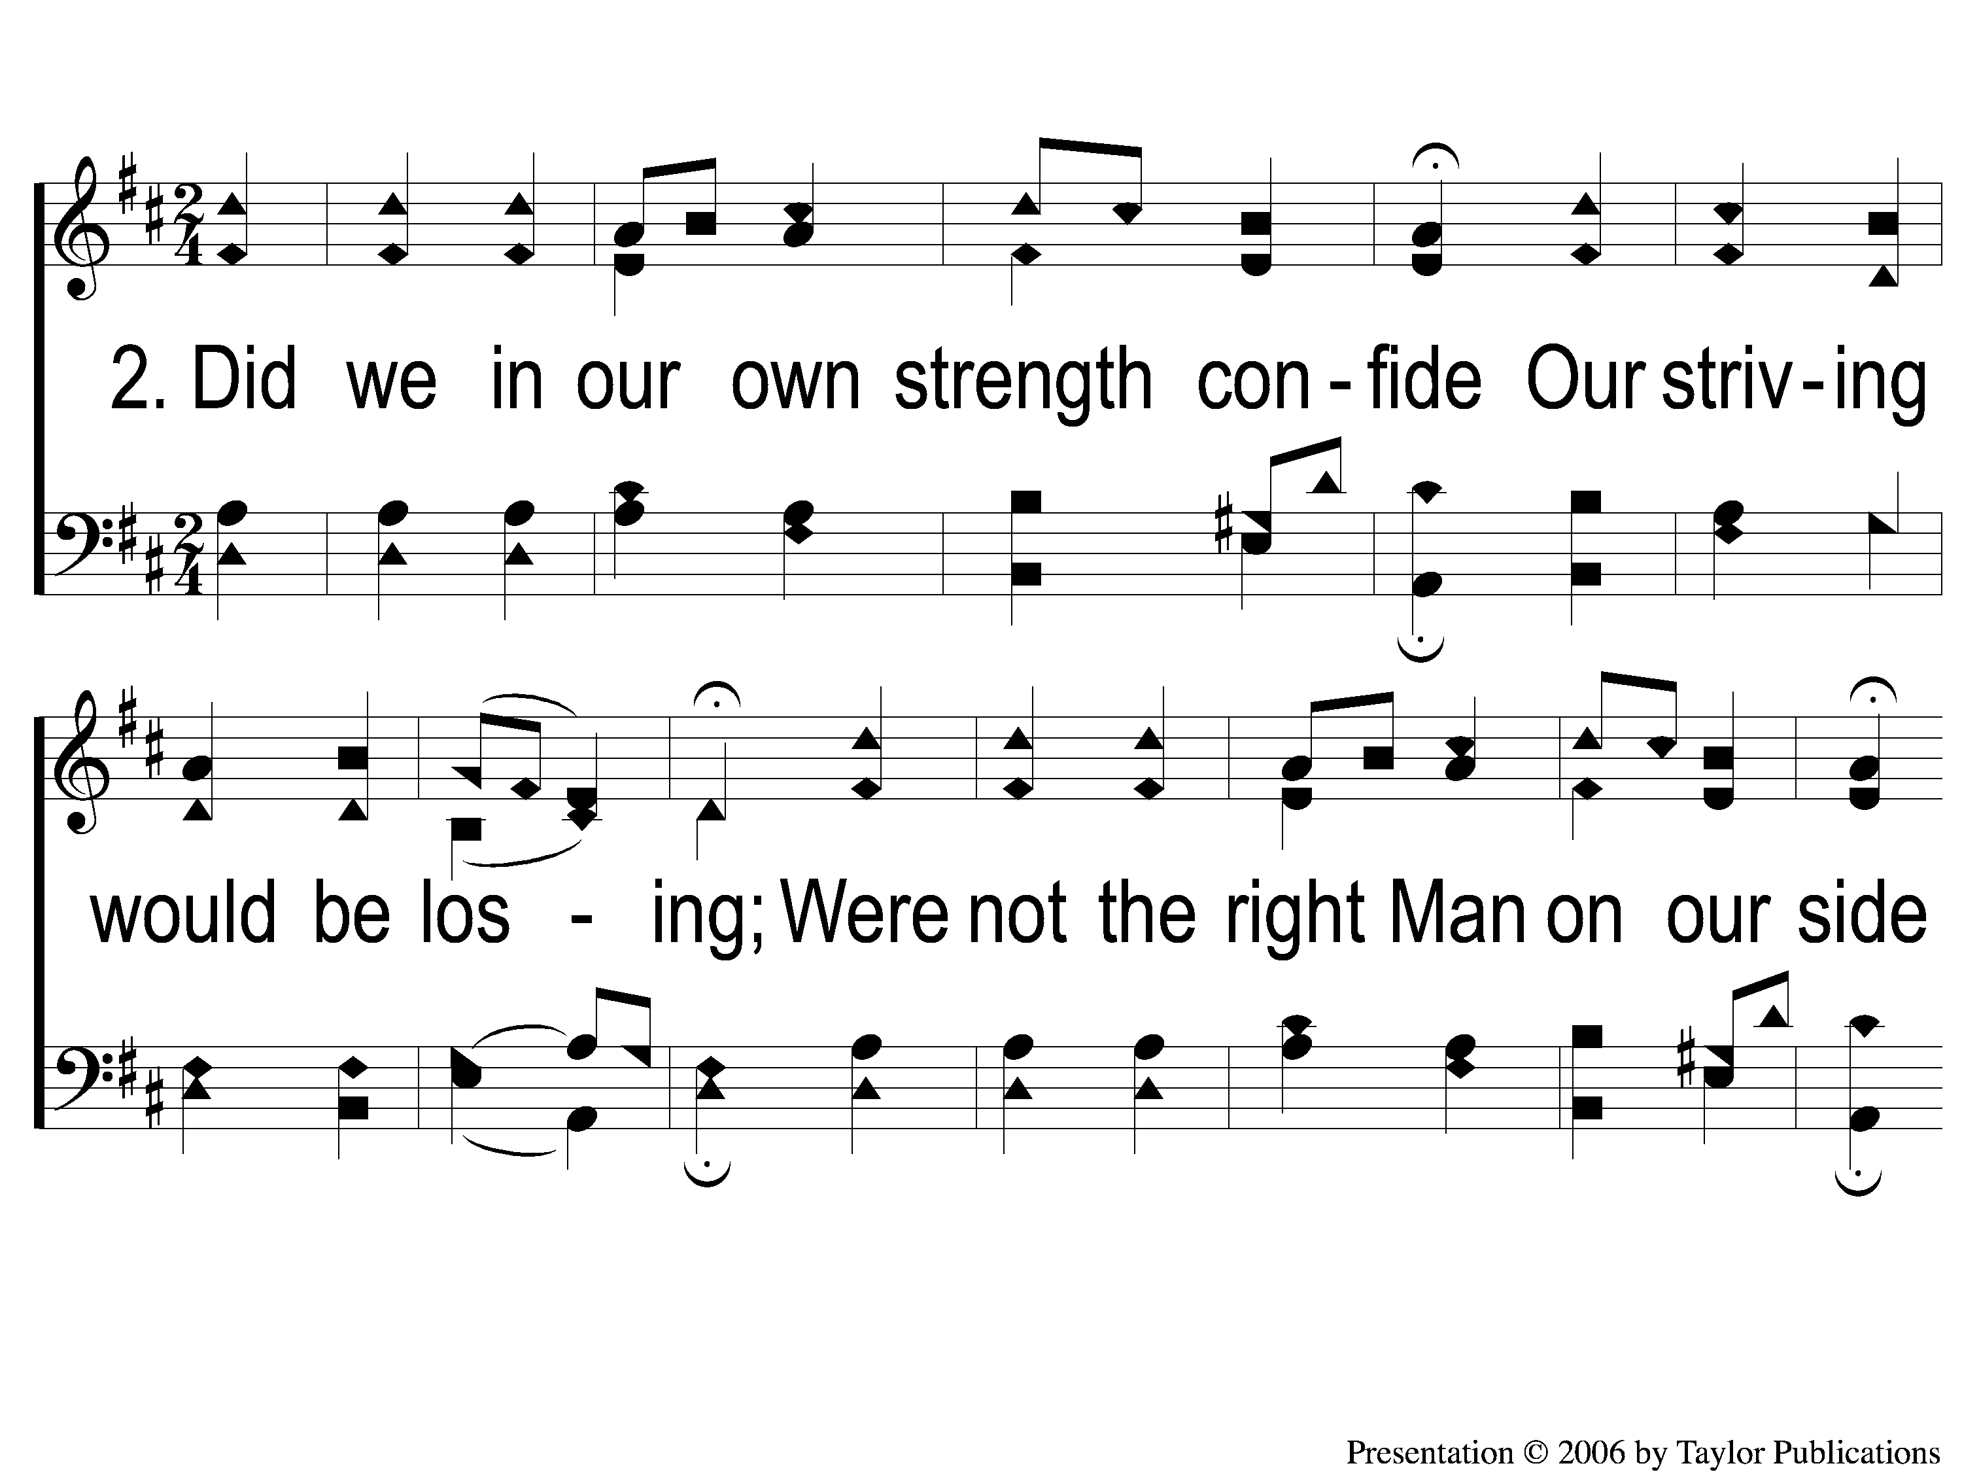
2-1 A Mighty Fortress
A Mighty Fortress
3

Slide 5
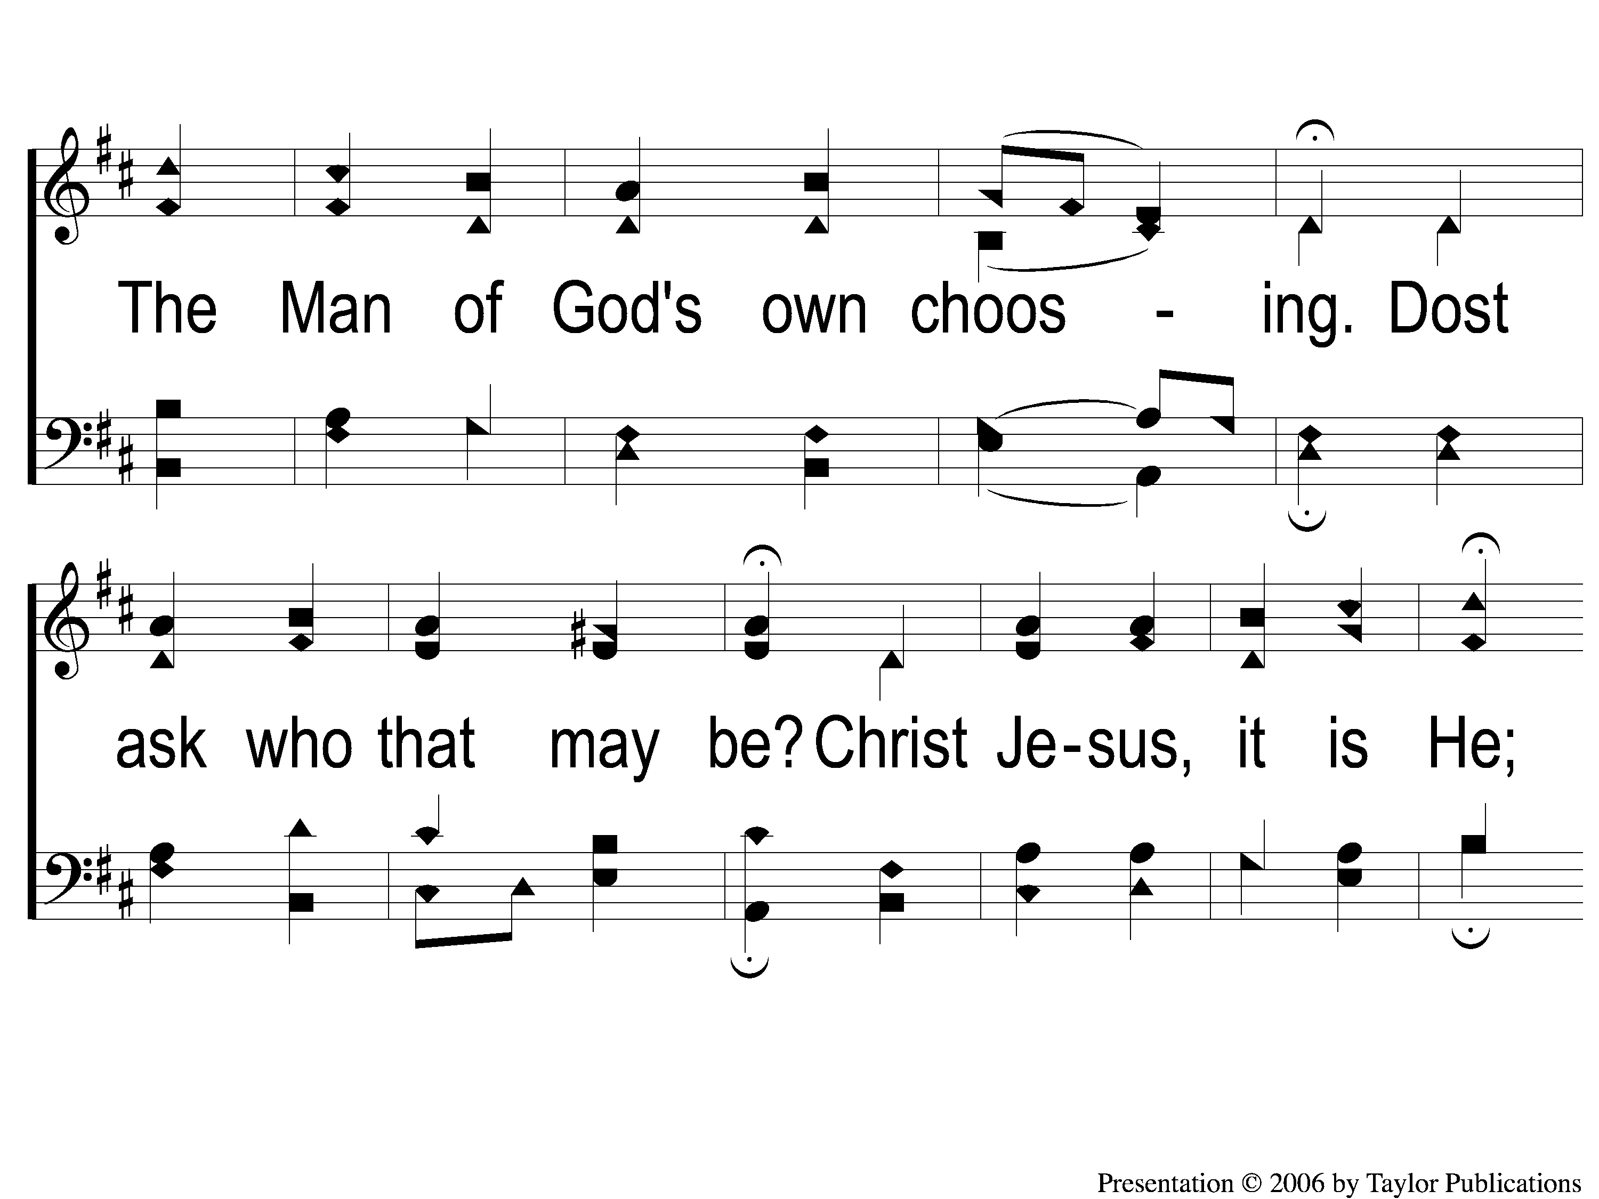
2-2 A Mighty Fortress
A Mighty Fortress
3

Slide 6
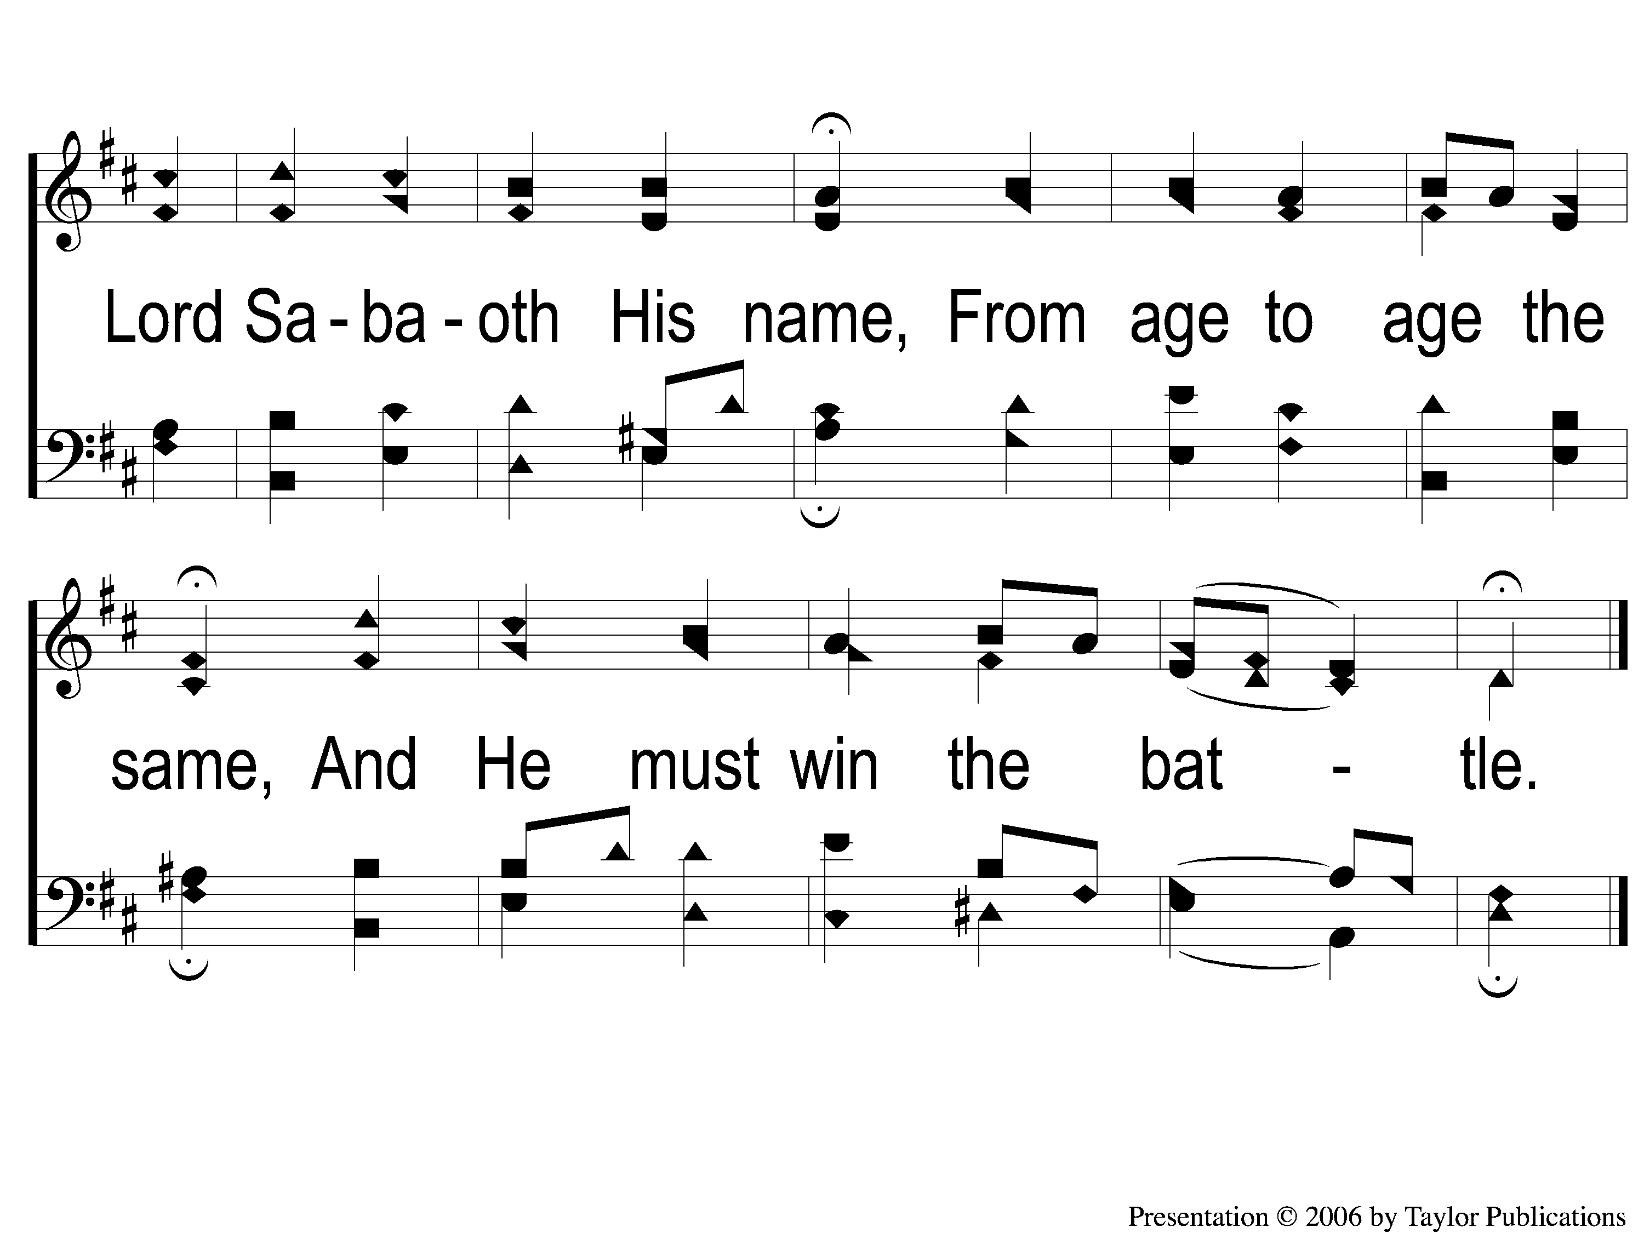
2-3 A Mighty Fortress
A Mighty Fortress
3

Slide 7
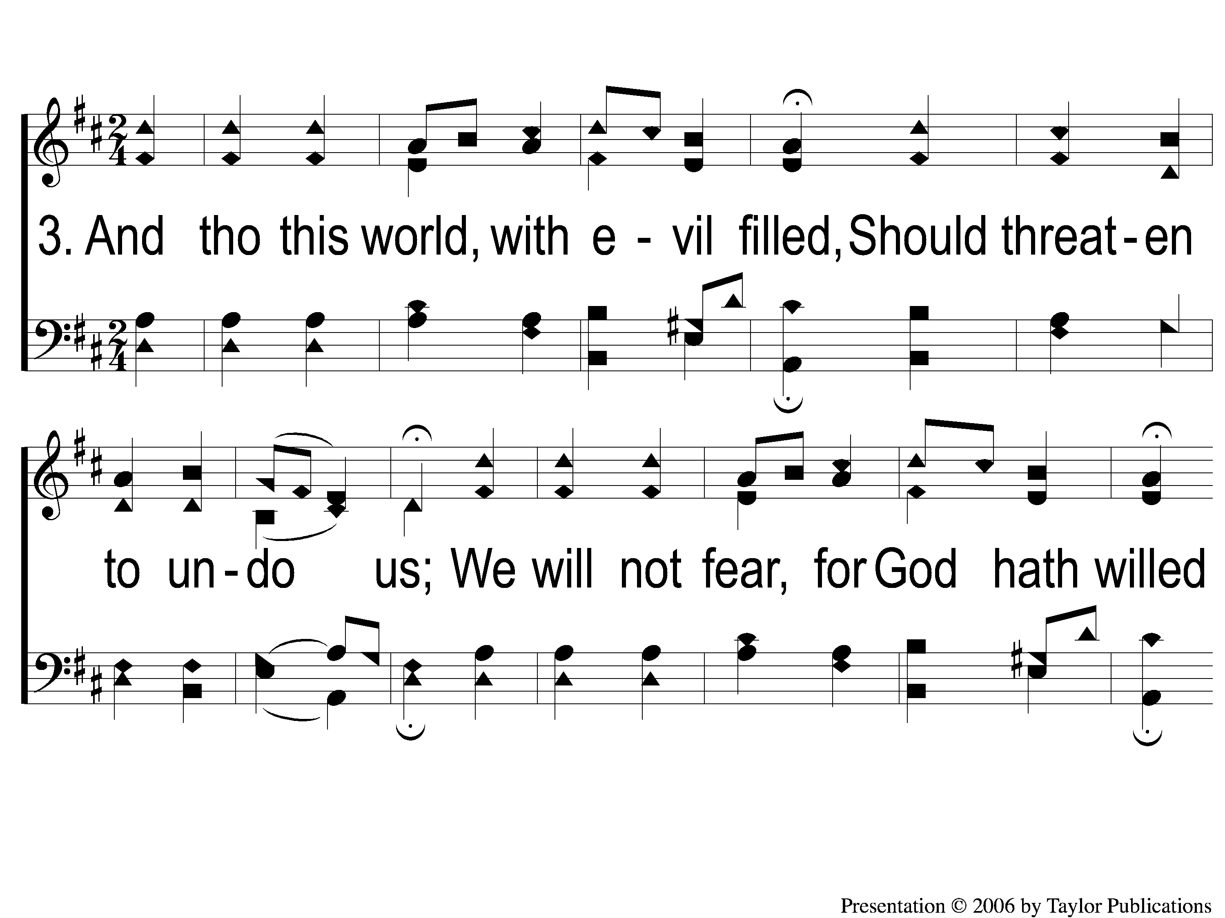
3-1 A Mighty Fortress
A Mighty Fortress
3

Slide 8
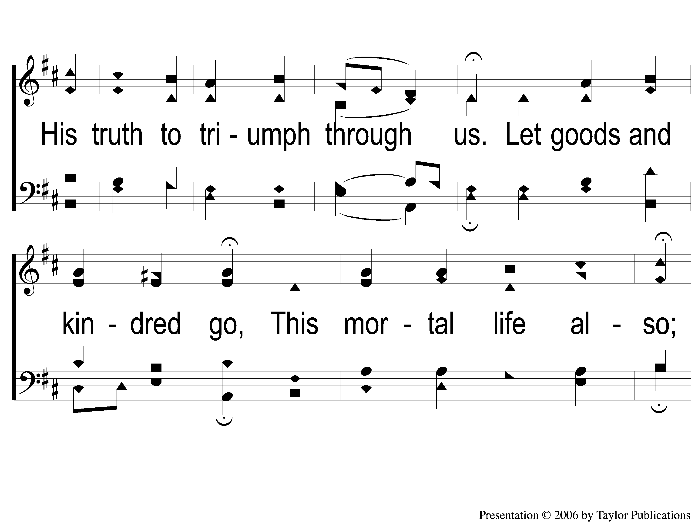
3-2 A Mighty Fortress
A Mighty Fortress
3

Slide 9
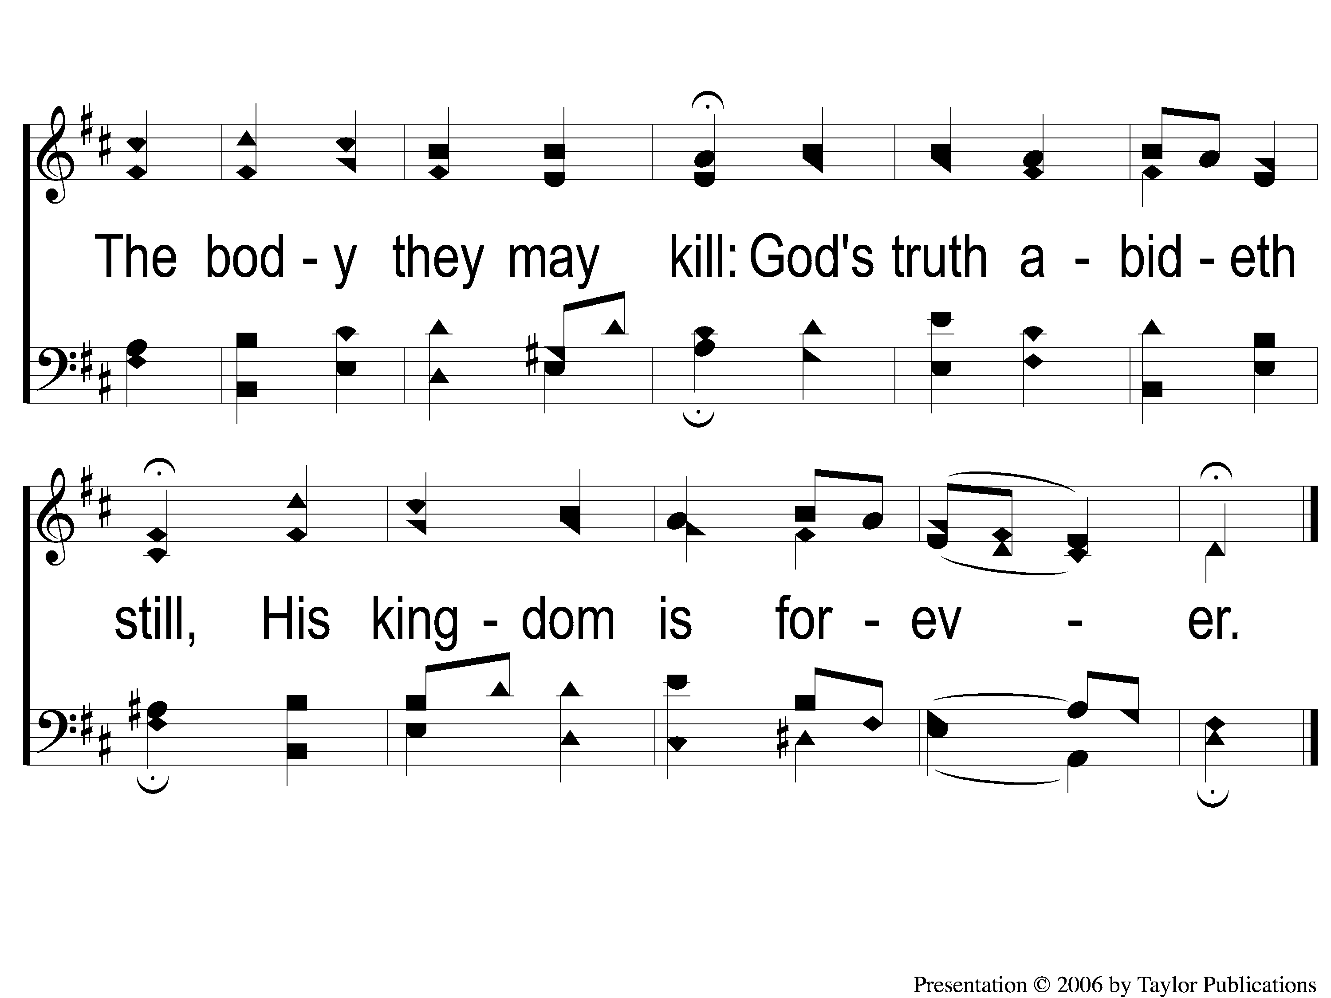
3-3 A Mighty Fortress
A Mighty Fortress
3

